Slide 1
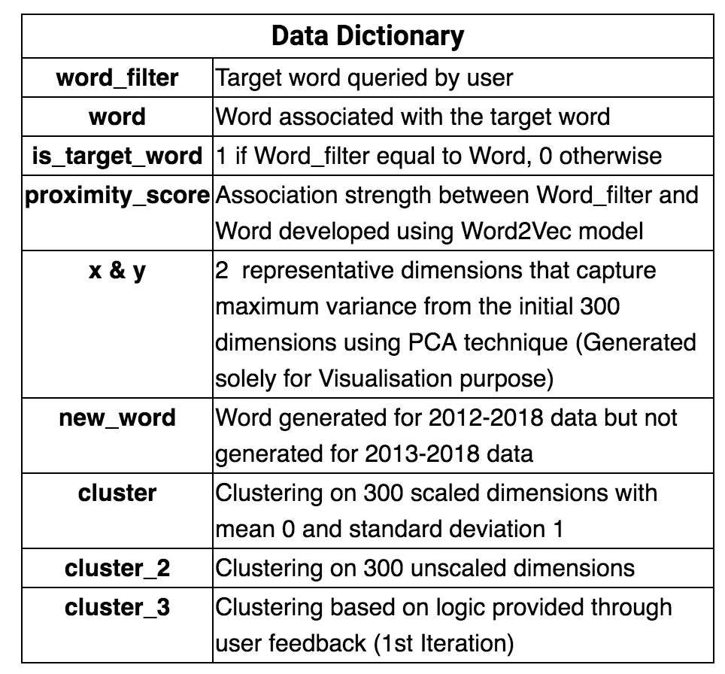
Note: Output “procurement_word2vec_output_4.csv” file generated after machine learning and used as data source for tableau visualisation

Slide 2
Tableau Dashboard | Version 1 | Version 2 | Version 3 (Additional Version upon request) | Version 4 (Additional Version upon request)
Output File | Tableau_Dashboard_v1_v2018.2.twbx | Tableau_Dashboard_v2_v2018.2.twbx | Tableau_Dashboard_v3_v2018.2.twbx | Tableau_Dashboard_v4_v2018.2.twbx
Data Source | Data Exploratory for Smart Solutions.xlsx Data Time period: 2013-2018 # Records: 254,315 | Data Exploratory for Smart Solutions.xlsx | Data Exploratory for Smart Solutions.xlsx + Data Exploratory for Smart Solutions v3.xlsx Data Time period: 2012-2018 # Records: 311,284 | Data Exploratory for Smart Solutions.xlsx + Data Exploratory for Smart Solutions v3.xlsx
Delivered as per Requirement | Generated 8071 words Top 10 most associated words to a queried word by user 20 clusters | Generated 8071 words Top 10 most associated words to a queried word by user 33 clusters based on user feedback | Generated 9095 words Top 10 most associated words to a queried word by user 33 clusters | Generated 9095 words Top 10 most associated words to a queried word by user 25 clusters based on user feedback
Additional Delivery | Meaningful descriptors tagged to generated cluster labels | Meaningful descriptors tagged to generated cluster labels | 2 cluster columns developed using different techniques to give user more option and flexibility Meaningful descriptors tagged to generated cluster labels New_Word, a column to flag new words generated with the addition of 2012 data | Meaningful descriptors tagged to generated cluster labels
Remarks |  | 2nd Iteration of v1 : User requested reclustering for a specific set of clusters |  | 2nd Iteration of v3: User requested reclustering for a specific set of clusters

